Slide 1
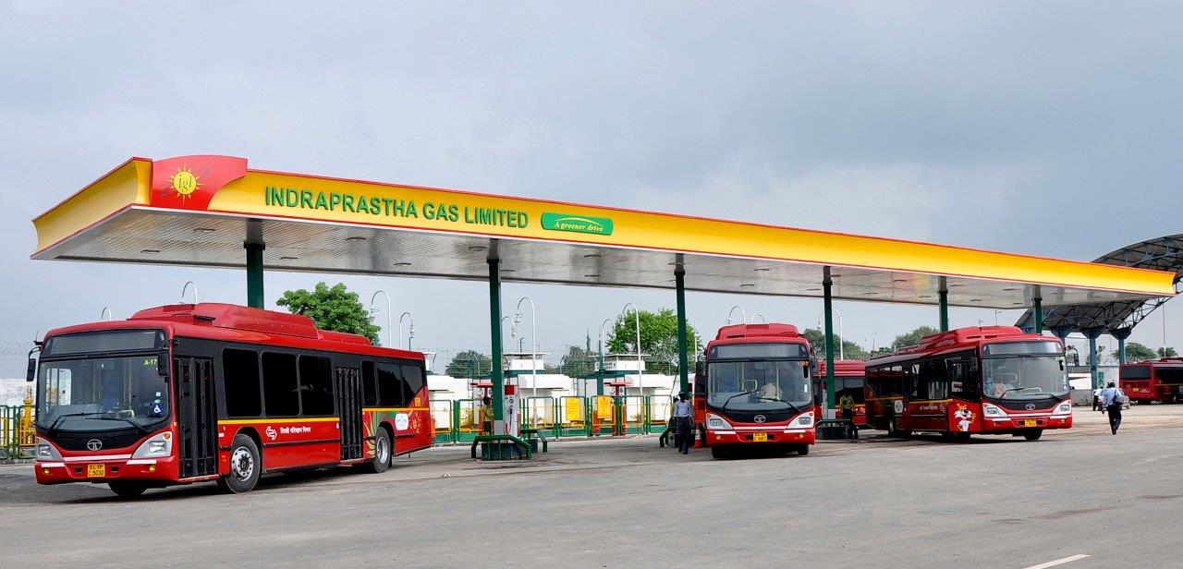
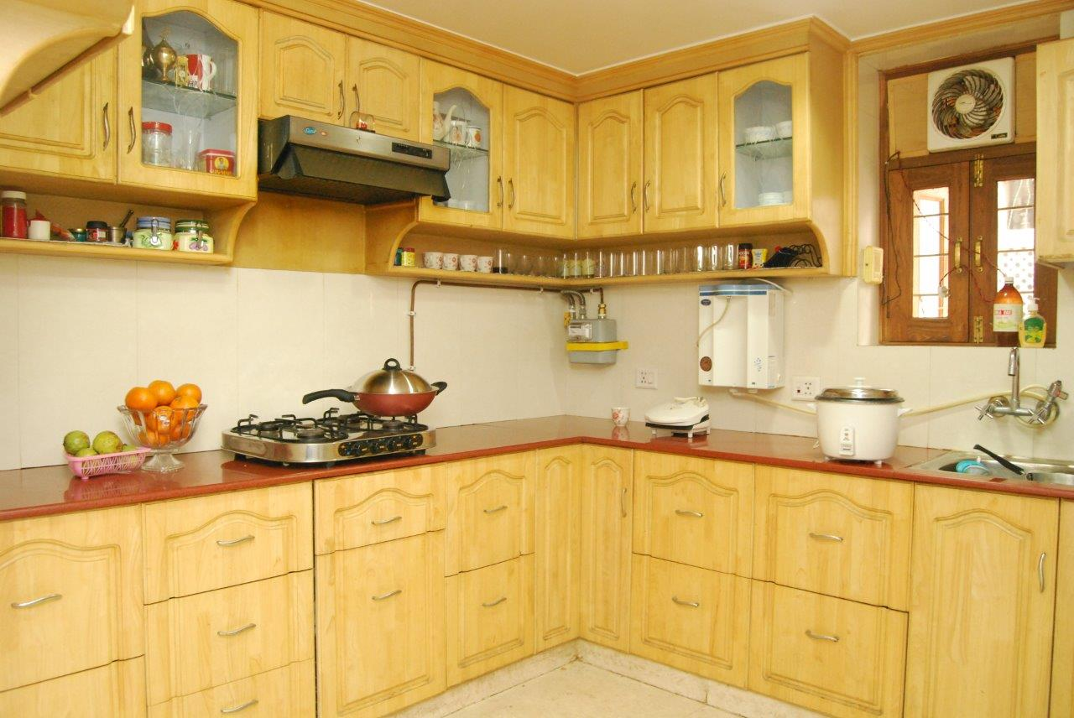
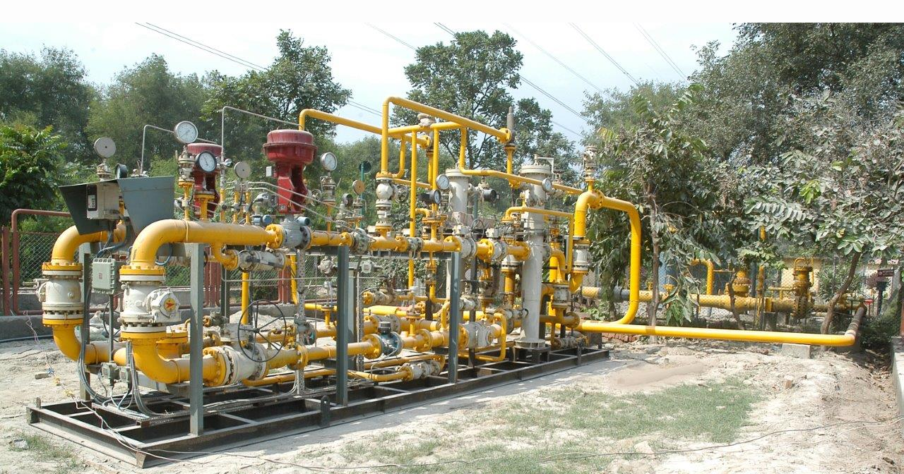
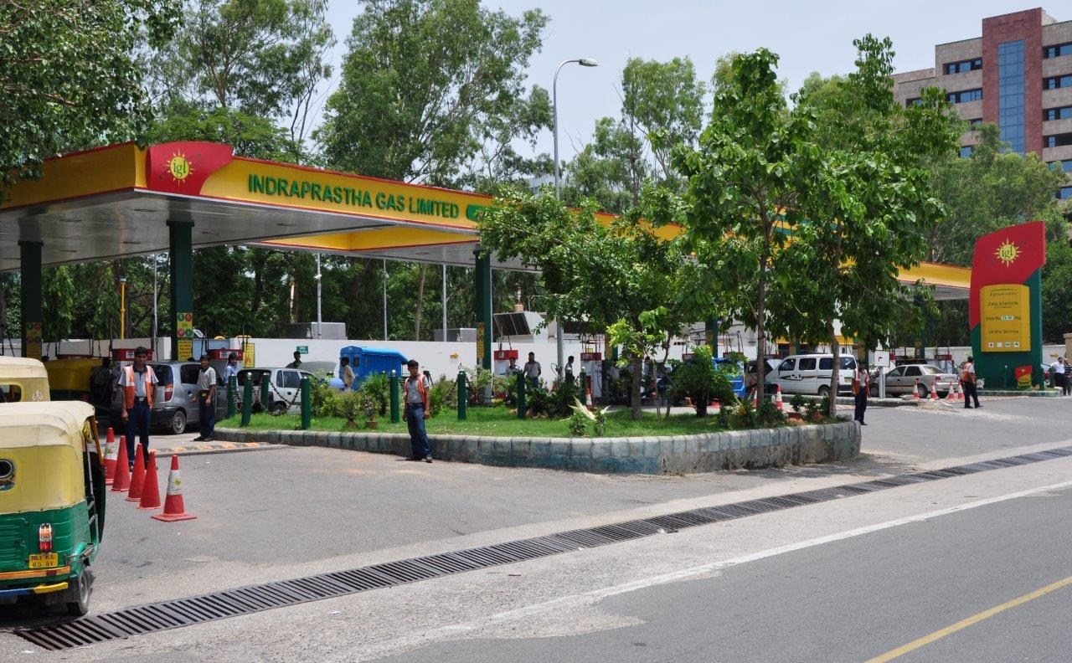
INDRAPRASTHA GAS LIMITED
An Overview
16.11.2016

Slide 2
Background
Incorporated in 1998, IGL is a Joint Venture of GAIL and BPCL. Govt. of NCT of Delhi is also holding 5% equity
IGL started its operations in NCT of Delhi in 1999 with only 9 CNG stations and 1000 PNG consumers
Today IGL has its operations in NCT of Delhi, Noida, Greater Noida and Ghaziabad with 418 CNG stations, 6.75 lacs residential consumers and 2.8 thousand industrial / commercial customers
Fuelling the largest CNG Bus fleet in the World

Slide 3
Shareholding Pattern

Slide 4
Management
IGL Board is fairly well diversified with ten members including two each from GAIL and BPCL, one from Govt. of Delhi and five independent directors.
The company is beneficiary of its strong parentage and gets significant support from GAIL and BPCL relating to operations and management.
By virtue of the presence of Govt. of Delhi as a minority shareholder, the company gets support for speedy administrative approvals.
The company has highly qualified senior management personnel with several years of experience in Oil & Gas sector.

Slide 5
Area of Operation
Delhi: National capital of India has huge demand potential:
where all public transport vehicles have to be necessarily run on CNG in view of the directions of the Hon. Supreme Court of India.
has the highest number of private cars compared to any other city of India
thickly populated having large number of residential & commercial complexes and hospitals etc..
Noida: Most advanced city of state of Uttar Pradesh having huge potential for CNG, PNG-Residential and commercial volumes.
Greater Noida and Ghaziabad: Residential cum Industrial towns of Uttar Pradesh having huge potential demand for PNG Residential, Commercial and Industrial.

Slide 6
New Geographical Area
IGL has been authorised for Rewari geographical area in the recent 6th round of bidding by PNGRB .
We propose to start 1st CNG station in Rewari by the end of this financial year i.e. 2016-17.

Slide 7
Segment & Current Sales Volume Mix

Slide 8
Sales Volumes
Figures in MMSCM

Slide 9
Gas Sourcing
Firm allocation from Govt. of India of domestic gas for the entire consumption of CNG and PNG Domestic segment. Lower prices of domestic gas makes the economics of switching to gas more attractive driving growth in CNG & PNG- Domestic segments which constitute around 82% of the total sales volumes.
Have tied up long term contract for RLNG to meet PNG Industrial & Commercial demand.
Buying short term gas from the open market (Shell, IOCL, Petronet, GSPC, BPCL etc.).

Slide 10
Current Gas Mix
 | MMSCMD | % Mix
APM | 2.90 | 67%
PMT | 0.97 | 22%
RLNG | 0.49 | 11%
Total | 4.35 | 100%

Slide 11
Growth in CNG

Slide 12
CNG Station Network
Figures in numbers

Slide 13
CNG Vehicles
Figures in numbers
Estimated figures based on various sources.

Slide 14
PNG Users
Figures in numbers

Slide 15
PNG Network
Figures in kilometers

Slide 16
Standalone Financial Data
Rs./Crores

Slide 17
Cumulative Capex (Rs. in crores)

Slide 18
Dividend
Dividend Policy provides liberal payout
Track record of last five years
Year % of equity
FY12 50
FY 13 55
FY 14 55
FY 15 60
FY 16 60

Slide 19
Acquisition of Equity in Other CGDs
IGL has acquired 50% equity share capital of Central UP Gas Limited (CUGL) for Rs. 69 crores. CUGL is engaged in the CGD in the cities of Kanpur and Bareilly, Unnao & Jhansi in Uttar Pradesh.
IGL has acquired 50% equity share capital of Maharashtra Natural Gas Limited (MNGL) at a price of Rs.38 per equity share aggregating to Rs. 190 crores. MNGL is engaged in the CGD in the city of Pune and nearby areas.
The above has resulted in diversification of geographical areas and consolidated earnings of IGL to improve by approx. 10 %.

Slide 20
Consolidated Results
First time consolidation of financial results has been done during FY 2015-16 with the Associates i.e. CUGL & MNGL on equity method considering 50% share in profit. The standalone and consolidated results are as under.
Parameter | Unit | Standalone | Consolidated
PAT | Rs. In Crores | 416.20 | 464.13
EPS | Rs./Share | 29.73 | 33.15

Slide 21
Growth-Strategy
Improve/Augment CNG infrastructure/Stations in Delhi & NCR to meet the additional demand in view of conversion of private cars and improvement in public transport system
Improve penetration of PNG business :
Penetration of network in all charge areas
Target Industrial/Commercial customers in both Delhi & NCR
Bidding for new cities
Synergy

Slide 22
Credit Strength
Healthy profitability with strong cash generations from operations.
Regained the status of zero debt company.
Comfortable working capital position.
ICRA Limited (An associate of Moody’s Investors Service) has reaffirmed highest credit ratings of AAA (Stable) for term loan and A1+ for short term loan.

Slide 23
Risks & Mitigations
Gas price
CNG & PNG-Residential prices remains competitive vis-à-vis petrol and subsidised LPG in view of allocation of domestic gas
Spot/short term gas is purchased to reduce the weighted average cost of gas for I/C segment.
Sourcing of gas
Firm allocation from Govt. of India for domestic gas –buying from GAIL.
Buying Long term TRLNG gas from GAIL/BPCL
Buying short term gas from the open market i.e. IOCL, GSPCL & Shell etc.

Slide 24
Safe Harbor Statement
This presentation has been prepared by Indraprastha Gas Limited solely for providing information about the company.
The information contained in this presentation is for general information purposes only, without regard to specific objectives, financial situations and needs of any particular person. Company do not accept any liability whatsoever, direct or indirect, that may arise from the use of the information herein.
The Company may alter, modify or otherwise change in any manner the content of this presentation, without obligation to notify any person of such revision or changes.

Slide 25
THANK YOU

