Slide 1
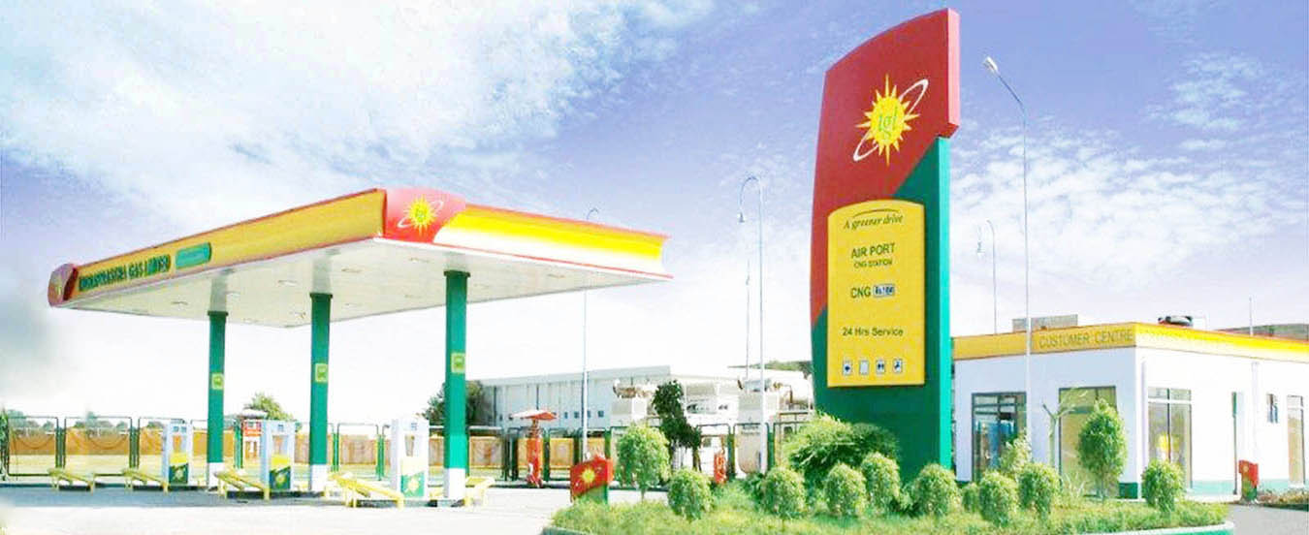

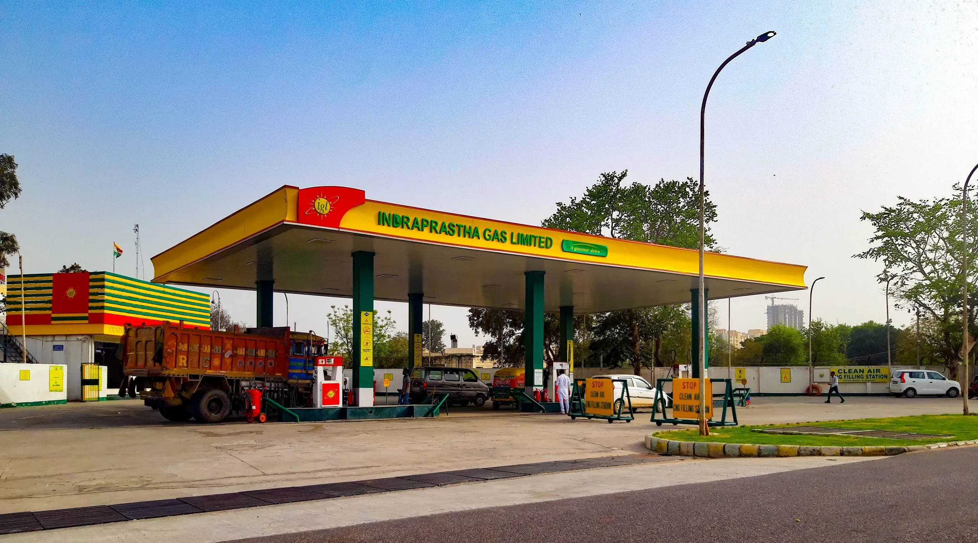
Indraprastha Gas Limited
An Overview
FY 2025-26

Slide 2

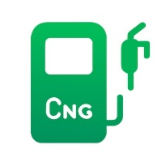
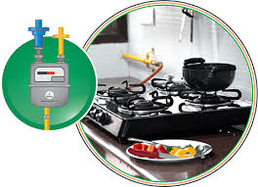



Background
Incorporated in 1998, IGL is a Joint Venture of GAIL and BPCL. Govt. of NCT of Delhi is also holding 5% equity
The company was listed in stock exchange in December 2003.
IGL started its operations in NCT of Delhi in 1999 with only 9 CNG stations and 1000 PNG consumers.
Where we operate
NCT of Delhi
Noida
Greater Noida
Ghaziabad & Hapur
Gurugram
Faridabad
Rewari
Karnal
Kaithal
Kanpur, Hamirpur, Fatehpur
Muzaffarnagar, Meerut, Shamli
Ajmer Pali Rajsamand
Banda, Chitrakoot Mahoba
1,024 CNG Stations
34.40 Lakh Domestic Connections
~13,078 Industrial & Commercial Connections
Fueling the largest CNG Bus fleet in the World

Slide 3
Shareholding Pattern As on 31 March 2026

Slide 4

Management
IGL Board is fairly well diversified with ten members: 2 each from GAIL and BPCL, 1 from Delhi Government and 5 independent directors.
The Company is beneficiary of its strong parentage and gets significant support from GAIL and BPCL relating to operations and management.
By virtue of the presence of Govt. of Delhi as a minority shareholder, the Company gets support for speedy administrative approvals.
The Company has highly qualified senior management personnel with several years of experience in oil & gas sector.

Slide 5
Areas of Operation
Delhi: National capital of India has huge demand potential:
  Where public transport vehicles have to necessarily run on CNG in view of the directions of the Hon'ble Supreme Court of India. However, in recent times the government is promoting EV and has converted nearly entire DTC fleet to EV.
  Has the highest number of private cars compared to any other city of India.
  Thickly populated having large number of residential & commercial complexes and hospitals etc.
Gautam Budh Nagar (Noida & Greater Noida): Most advanced cities of state of Uttar Pradesh having huge potential for CNG, PNG-Residential and commercial volumes.
Ghaziabad: Residential cum industrial town of Uttar Pradesh having huge potential demand for PNG residential, commercial and industrial. PNGRB has recently clarified that the GA of Ghaziabad includes Ghaziabad and Hapur Districts.
Rewari, Dharuhera & Bawal: IGL was authorized for Rewari geographical area in the 6th round of bidding by PNGRB. IGL has commissioned 62 CNG stations in the GA and sale of PNG to around 37,900 domestic households. Bawal being an industrial town of Haryana having huge potential demand for industrial PNG.
Karnal: IGL was authorized for Karnal geographical area in the 8th round of bidding by PNGRB. IGL has commissioned 33 CNG stations in Karnal GA. PNG domestic, industrial and commercial sale has also started in the GA.

Slide 6
Areas of Operation
Meerut, Muzaffarnagar & Shamli: IGL has been authorized for Meerut (except area already authorized), Muzaffarnagar & Shamli geographical area in the 9th round of bidding by PNGRB in which IGL has commissioned 50 CNG stations and sale of PNG to 75,800 domestic households, commercial and industrial customers.
Gurugram: IGL has laid 84 kms steel pipeline and 383 kms MDPE pipeline infrastructure in Gurugram. The permission has been given for the area between west side of Sohna Road and NH 8 in Gurugram district. IGL has commissioned 30 CNG stations in the GA. Dispute regarding license to operate in the entire Gurugram is subjudice.
Kaithal; Kanpur, Fatehpur & Hamirpur; and Ajmer, Pali & Rajsamand: IGL has been authorized for Kaithal; Kanpur (except area already authorized), Fatehpur & Hamirpur; and Ajmer, Pali & Rajsamand areas in the 10th round of bidding by PNGRB. IGL has commissioned 16 CNG stations in Kaithal, 30 CNG stations in Kanpur GA and 83 CNG stations in Ajmer GA. PNG domestic, industrial and commercial sales has also started in all the 3 GA’s.
Banda, Chitrakoot & Mahoba: IGL has been authorized for Banda, Chitrakoot & Mahoba in the 11th round of bidding by PNGRB. IGL has commissioned 31 CNG stations in GA. Sale of PNG to domestic household and commercial customers has also started.
Faridabad 1 and Gurugram 1: Portions of Gurugram and Faridabad were authorized to IGL by PNGRB vide order dated 26.04.2023. IGL has submitted acceptance towards Grant of Authorization with PNGRB on 13.04.2026 and has started with technical and feasibility study in the authorised portions of Gurugram and Faridabad.

Slide 7
Current Sales Volume Mix (%)
Total Sales – 9.39 million SCMD
Delhi: 5.44 million SCMD
UP: 2.49 million SCMD
Haryana: 0.81 million SCMD
Rajasthan: 0.15 million SCMD
NG: 0.50 million SCMD

Slide 8
Yearly Sales Volume Segment wise (Million SCM)

Slide 9

Gas Sourcing
Allocation from Government of India of domestic gas for CNG and PNG Domestic segment.
Lower prices of domestic gas makes the economics of switching to gas more attractive driving growth in CNG & PNG- Domestic segments which constitute around 82% of the total sales volumes.
During FY 2025-26, the gas portfolio of the Company comprises 57% domestic gas and 43% RLNG.
Have tied up long term/ mid term/short term contract for RLNG to meet PNG Industrial & Commercial demand and shortfall in Domestic Gas allocation for CNG & D-PNG.
Buying short term gas from the open market through tendering and IGX on need basis.

Slide 10
Current Gas Mix (%) (Overall Purchases)

Slide 11
Growth in CNG Segment

Slide 12
CNG Station Network
Station | IGL | DTC/ UPSRTC | OMC | DODO | Total
Online | 197 | 64 | 505 | 96 | 862
Daughter Booster | 0 | 0 | 95 | 9 | 104
Daughter | 0 | 0 | 54 | 0 | 54
LNG | 4 | 0 | 0 | 0 | 4
Total | 201 | 64 | 654 | 105 | 1024

Slide 13
CNG Vehicles (Figures in Nos.) IGL GA’s
47,955
15,88,955
*Re casted Estimated figures based on various sources. Does not exclude vehicles phase out, if any.

Slide 14
PNG Connections
13,078

Slide 15
PNG Network (Figures in kilometers)

Slide 16
Cumulative Capex (Rs./Crores)

Slide 17
Standalone Financial Data (Rs./ Crores)
* Considering the impact of bonus issue from FY 2024-25

Slide 18
Dividend
As per the dividend policy approved by the Board, the Company will endeavor to ensure the right balance between the quantum of dividend paid to its shareholders and amount of profits retained in the business for various purposes.
The Company decides the dividend payout after considering the net profits earned, free cash generated by the Company and future capex requirements.
Track records of last 5 years is as under:
Year | % of face value of share | Rs./Share
FY 20-21 | 180% | 3.60
FY 21-22 | 275% | 5.50
FY 22-23 | 650% | 13.00
FY 23-24 (interim) | 200% | 4.00
FY 23-24 (Final) | 250% | 5.00
FY 24-25 (Interim) | 275% | 5.50
FY 24-25 (Final) | 75% | 1.50
FY 25-26 (Interim) | 163% | 3.25
FY 25-26 (Proposed Final) | 75% | 1.50

Slide 19
Equity in Other CGDs and results
IGL has acquired 50% equity share capital of Central UP Gas Limited (CUGL) at a price of Rs. 23 per equity share aggregating to Rs.68 crores.
CUGL is engaged in the CGD business in the cities of Kanpur and Bareilly, Unnao & Jhansi in Uttar Pradesh.
IGL has acquired 50% equity share capital of Maharashtra Natural Gas Limited (MNGL) at a price of Rs.38 per equity share aggregating to Rs.190 crores.
MNGL is engaged in the CGD business in the city of Pune, Pimpri-Chinchwad including adjoining areas of Talegaon, Chakan and Hinjewadi, Nasik, Dhule, Sindhudurga, Buldana, Nanded, Parbhani districts in Maharashtra, part of Valsad in Gujarat, Ramanagara in Karnataka and Nizamabad, Adilabad, Nirmal, Mancherial, Kumuram Bheem, Asifabad and Kamareddy Districts in Telangana.
IGL has acquired 51% equity share capital i.e. 3.446 crores shares of Rs. 10 each fully paid in IGL Genesis Technologies Limited (IGTL) incorporated on 15.06.2023. The primary objective of subsidiary is manufacturing, supply, selling and distribution of gas & other meters and other allied goods & services.
The standalone and consolidated financial results for the year ending 31.03.2026 with the subsidiary on line-by-line method and associates i.e. CUGL & MNGL on equity method considering 50% share in profit are as under:
Parameter | Unit | Standalone | Consolidated
Total Comprehensive Income | Rs. in Crores | 1,368 | 1,548
EPS | Rs./Share | 9.74 | 11.07

Slide 20
Future Outlook
Approximately Rs. 1,980 crores of capex is planned for the FY 2026-27. The capex covers existing GA of Delhi NCR other GAs allotted to the company and other business opportunities. Approx. 78 new CNG stations and 3 LNG stations are planned to be commissioned during the FY 2026-27.
The Company is making efforts to reach the gas sales volume up to approx. 10.60 million SCMD in FY 2026-27.
The Company is also venturing into electric vehicle charging segment, already having 30 EV charging stations in Delhi and is planning to commission more stations during FY 2026-27.
The Company has commissioned four LNG station, one in Ajmer GA, 2 in Gautam Budh Nagar and 1 in Rewari GA and is planning to commission 3 more LNG stations in FY 2026-27.
The Company has successfully commissioned and started production during the current year at meter manufacturing plant through its subsidiary, IGL Genesis Technologies Ltd.
The Company has approached state transport undertakings for running inter state passenger buses on CNG. The state transport undertaking of 2 states has deployed approx. 305 and 200 CNG buses respectively on inter state route and approx. 100 new buses are planned to be started in FY 2026-27. Also discussion with other State Governments is under process and their response is awaited in the matter.
The Company is actively looking for growth avenues and is open for organic/inorganic growth opportunities. The Company is also looking for opportunities to diversify in other areas.

Slide 21
Credit Strength
Risk and Mitigation
Healthy profitability with strong cash generations from operations.
Zero debt company and comfortable working capital position.
Care Ratings Ltd. has reaffirmed highest credit ratings of AAA (Stable) for bank facilities .
CNG & PNG prices remains competitive vis-à-vis petrol and subsidized LPG in view of allocation of domestic gas.
To mitigate the risk, company has signed mid term/long term gas purchase agreements.

Slide 22
Safe Harbor Statement
This presentation has been prepared by Indraprastha Gas Limited solely for providing information about the Company.
The information contained in this presentation is for general information purposes only, without regard to specific objectives, financial situations and needs of any particular person. Company do not accept any liability whatsoever, direct or indirect, that may arise from the use of the information herein.
The Company may alter, modify or otherwise change in any manner the content of this presentation, without obligation to notify any person of such revision or changes.

Slide 23

Thank You

